Slide 1
SECURE DATA HIDING IN IMAGES USING STEGANOGRAPHY
CAPSTONE PROJECT
Presented By: Aliya Asif Sayyed
Student Name : Aliya Asif Sayyed
College Name : MIT ACSC, PUNE
Department : Cyber Security

Slide 2
OUTLINE
Problem Statement
Technology used
Wow factor
End users
Result
Conclusion
Git-hub Link
Future scope

Slide 3
Problem Statement
With the rise of digital communication, securing sensitive data has become a significant challenge. Traditional encryption methods make the presence of secret data obvious, leading to potential attacks. This project addresses the need for covert data transmission by embedding secret messages within images using steganography, ensuring confidentiality and undetectability.

Slide 4
Technology used
The project utilizes LSB (Least Significant Bit) Steganography, DCT (Discrete Cosine Transform), and DWT (Discrete Wavelet Transform) for secure data hiding. Tools such as Python, OpenCV, and PIL (Python Imaging Library) are used for image processing, while cryptographic techniques enhance security.

Slide 5
Wow factors
Unlike traditional encryption, steganography allows secret communication without raising suspicion. The embedded data is nearly imperceptible to the human eye, making it difficult for attackers to detect. The use of advanced image processing techniques ensures high security while maintaining image quality.

Slide 6
End users
This technology benefits government agencies, intelligence organizations, journalists, and individuals requiring secure communication. It is also useful in digital watermarking, copyright protection, and secure document transmission for industries such as banking and cybersecurity.

Slide 7
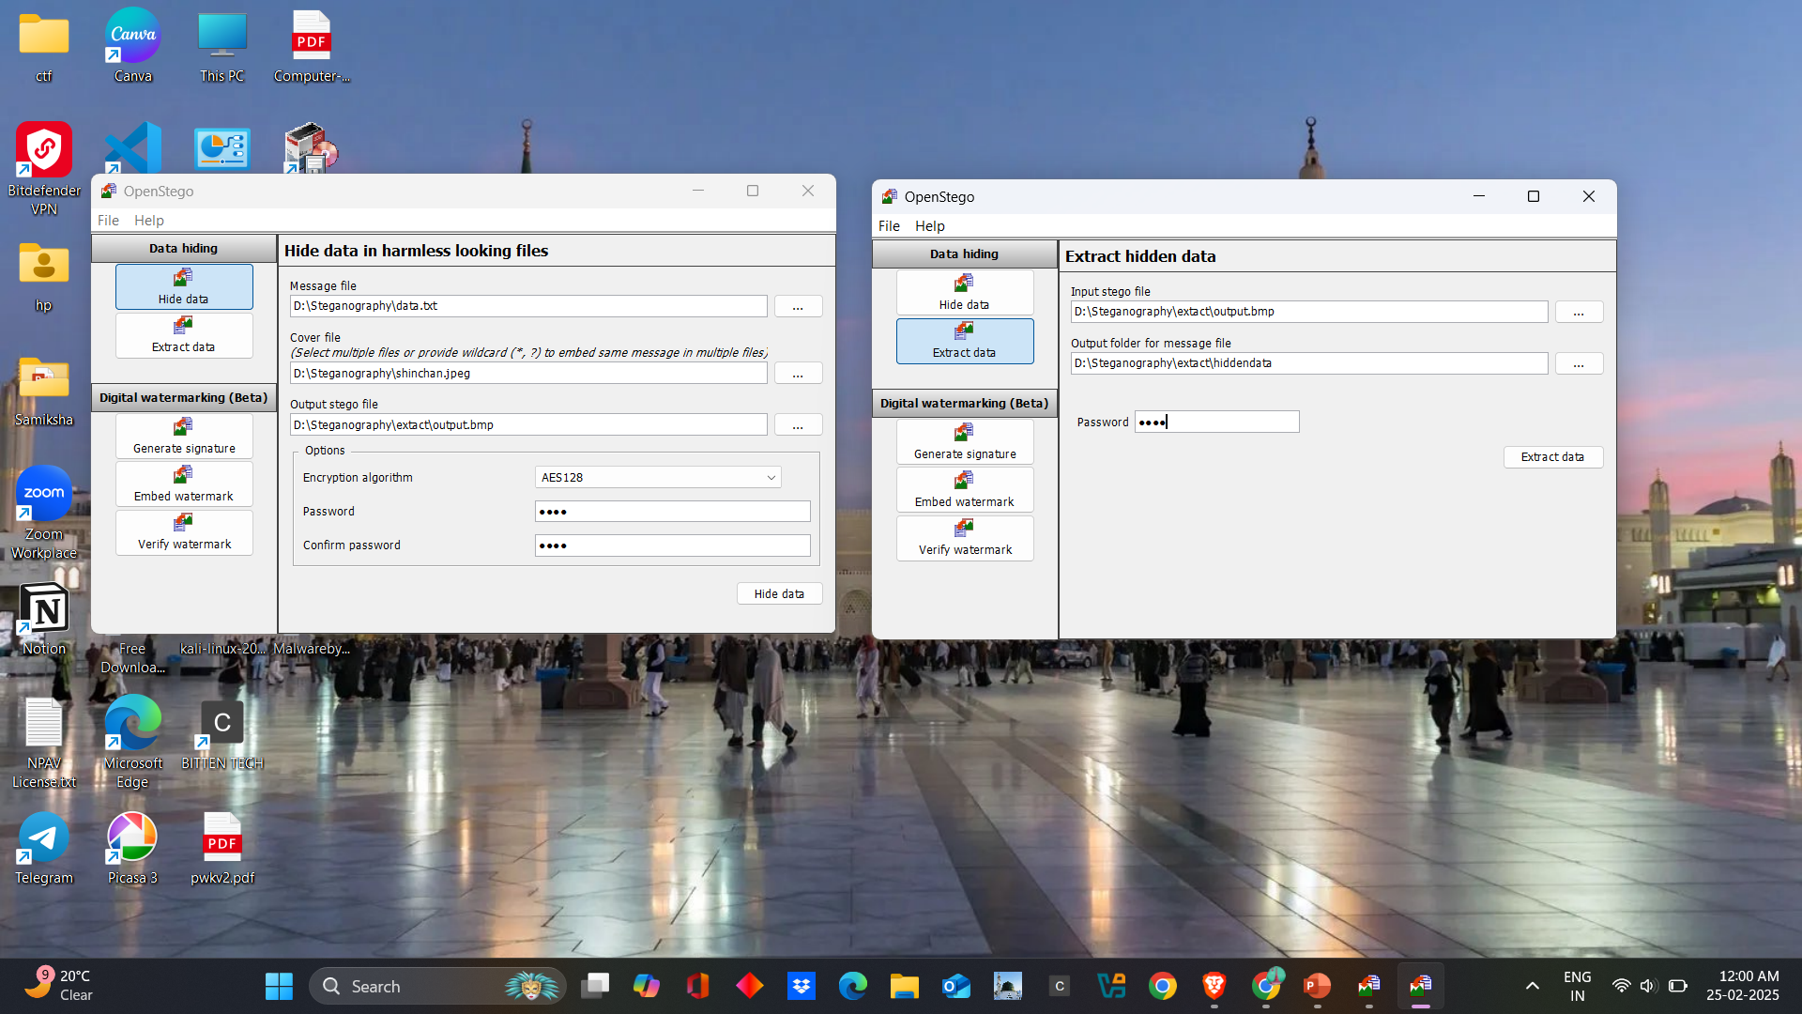
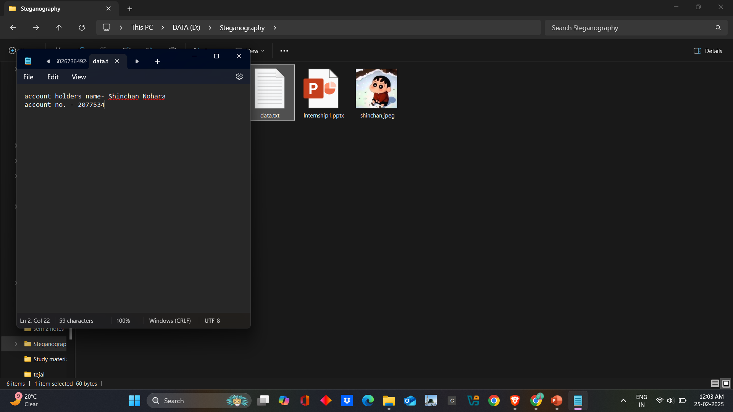
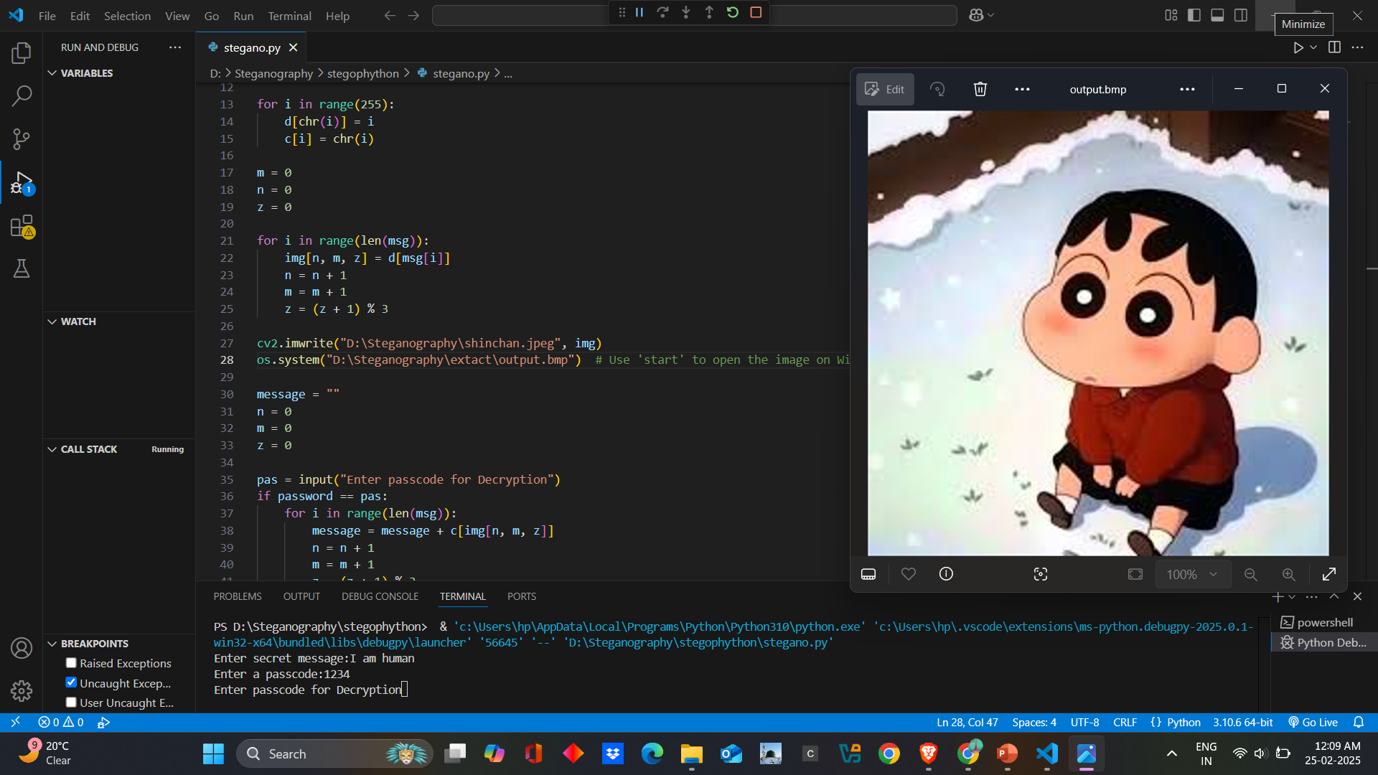
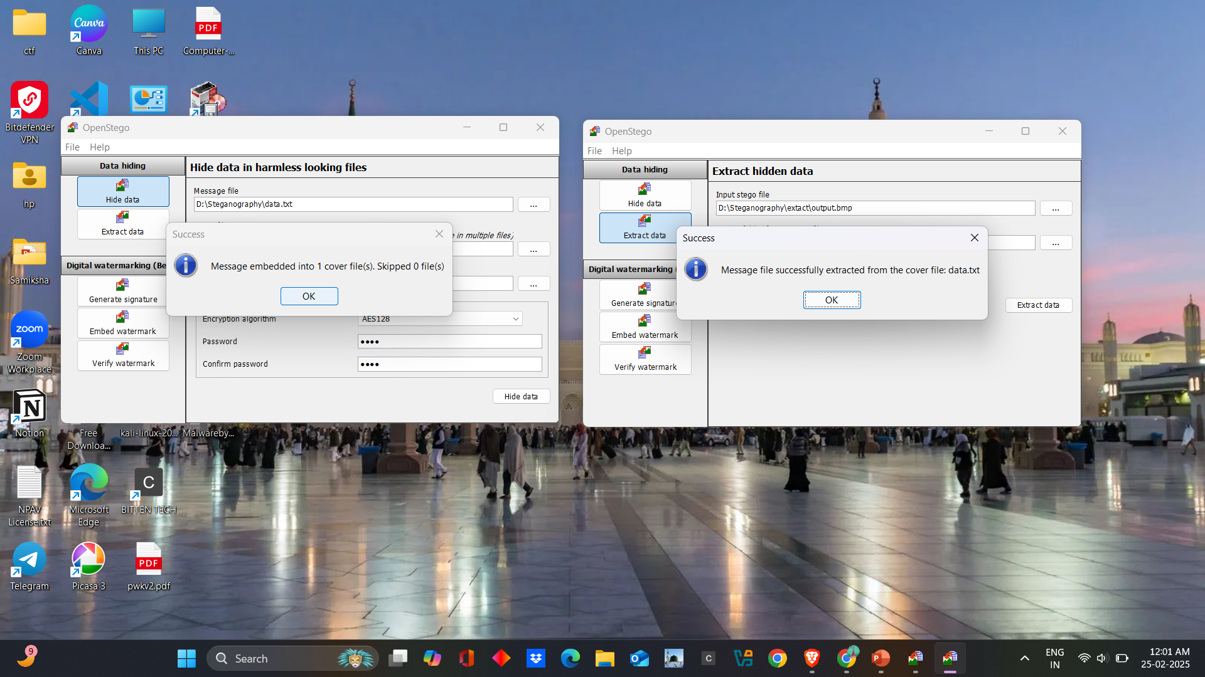
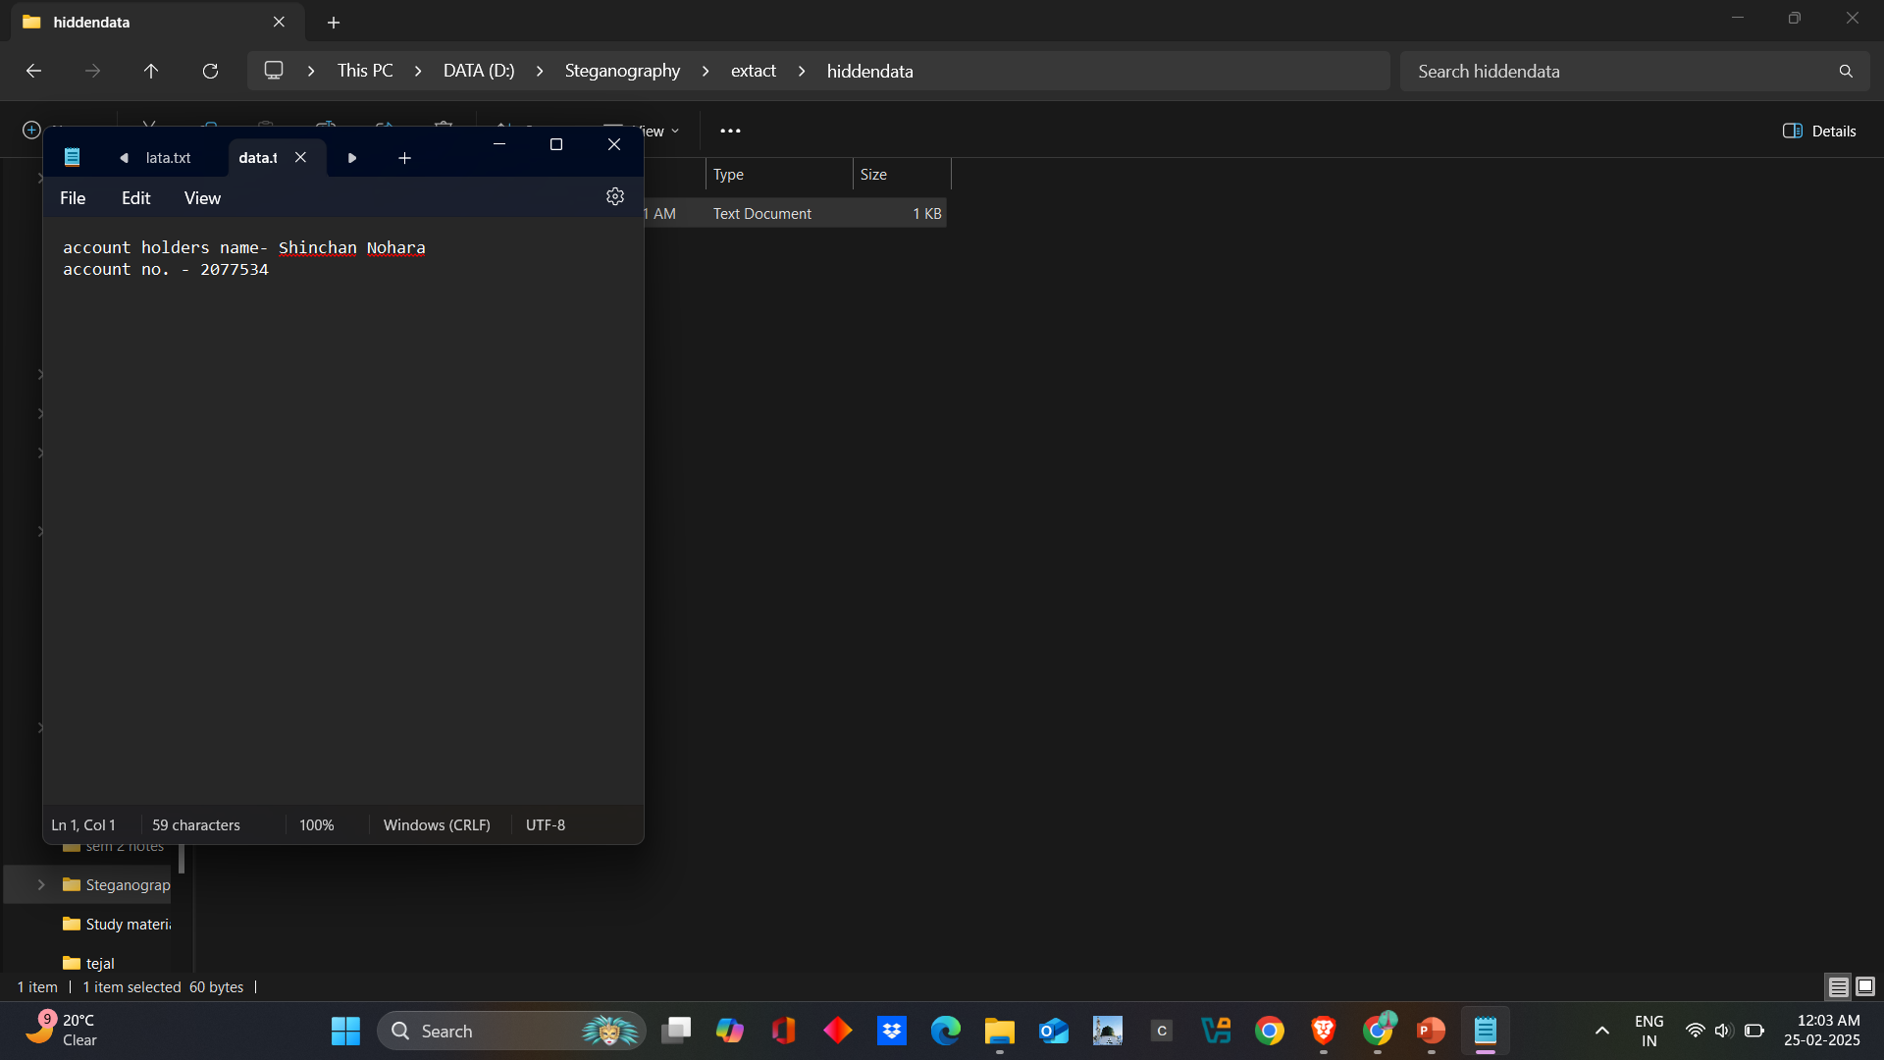
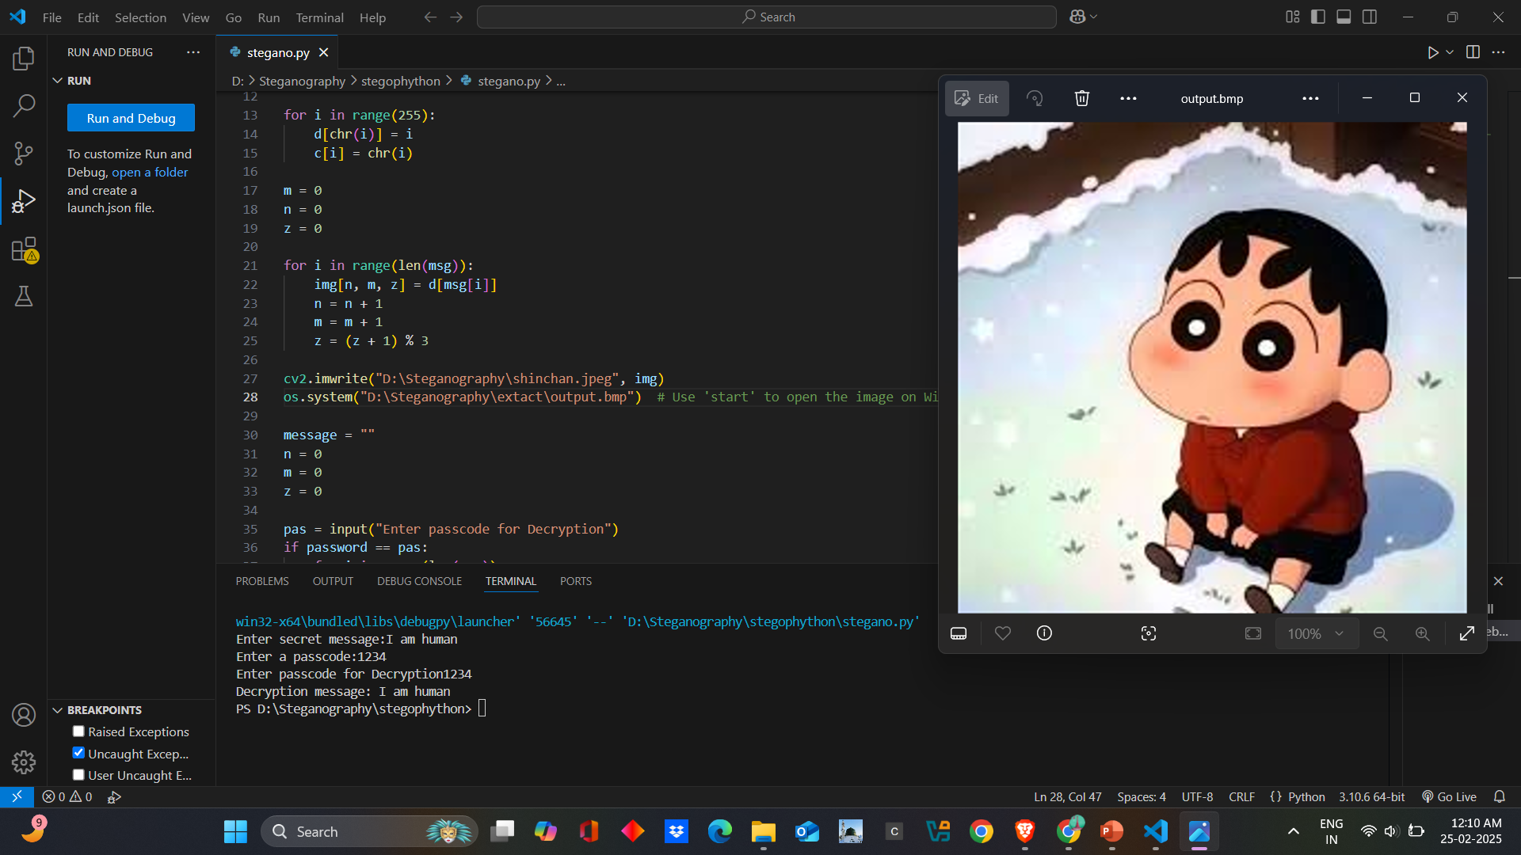
Results
Encrypt&Decrypt using open Stego:
Output using open Stego:
Output using Python:

Slide 8
Conclusion
Steganography provides an effective method for covert communication by embedding secret data within images. The project demonstrates how modern techniques can enhance security while preserving data integrity. It serves as a low-risk, high-security solution for secure data exchange.

Slide 9
GitHub Link
https://github.com/Aliya65/Steganography

Slide 10
Future scope(optional)
Future advancements include integrating AI-based detections resistance improved payload capacity and multi-layer encryption for enhanced security. The application can be extended to video and audio steganograpgy. For broader use cases, making it an essential tool in cyber security and digital forensics.

Slide 11
THANK YOU!!

